Slide 1
EIE 411
COMPUTER ORGANIZATION AND ARCHITECTURE
MODULE 2: COMPUTER ARITHMETIC

Slide 2
NUMBER SYSTEMS
A computer understands only numbers – mainly 1s and 0s.
Everything in computer – numbers, letters, symbols and even computer instructions are all represented by numbers.
The most important number systems are binary, hexadecimal, octal and decimal.

Slide 3
NUMBER SYSTEMS
At the most basic machine language level, the computer only understands binary numbers – 1s and 0s.
Hexadecimal and octal are more compact ways of representing binary numbers - mostly at the assembly language level.
Decimal is the natural way humans represent numbers – used in higher level languages.

Slide 4
NUMBER COVERSIONS REVIEW
Converting both integers and fractional numbers
Decimal to binary
Binary to decimal
Decimal to octal
Octal to decimal
Decimal to hexadecimal
Hexadecimal to decimal

Slide 5
NUMBER COVERSIONS REVIEW
Binary to hex
Hex to binary
Binary to octal
Octal to binary
Other binary-based formats
Binary-coded decimals (BCD)
Gray code (reflected binary code)

Slide 6
NUMBER COVERSIONS REVIEW
Binary to hex
Hex to binary
Binary to octal
Octal to binary
Other binary-based formats
Binary-coded decimals (BCD)
Gray code (reflected binary code)

Slide 7
NUMBER SYSTEMS CONCEPTS
Radix or base
Exponent
Mantissa, significand or coefficient
Fraction
Most significant digit (or bit)
Least significant digit (or bit)

Slide 8
FIXED POINT NUMBERS
A fixed point number has a specific number of bits (or digits) reserved for the integer part (the part to the left of the radix point) and a specific number of bits reserved for the fractional part (the part to the right of the radix point). No matter how large or small your number is, it will always use the same number of bits for each portion. Every bit of code that processes such numbers has to have built-in knowledge of where the radix point is.

Slide 9
FLOATING POINT NUMBERS
With floating-point representation, the placement of the radix point can ‘float’ relative to the significant digits of the number.

Slide 10
FIXED POINT ADDITION & SUBTRACTION
Unsigned binary representation
Representing signed binary numbers
Sign-magnitude representation
1’s complement representation
2’s complement representation
Solves the problem of multiple representation for zero, end-around carry
Fixed point addition and subtraction

Slide 11
DECODING 1'S COMPLEMENT NUMBERS
Check the sign bit (denoted as S).
If S=0, the number is positive and its absolute value is the binary value of the remaining n-1 bits.
If S=1, the number is negative and its absolute value is the binary value derived by inverting the remaining n-1 bits..

Slide 12
DECODING 2'S COMPLEMENT NUMBERS
Check the sign bit (denoted as S).
If S=0, the number is positive and its absolute value is the binary value of the remaining n-1 bits.
If S=1, the number is negative. You can get the absolute value using any of these 3 methods:
Method 1: Subtract 1 from the remaining n-1 bits then invert.
Method 2: Invert the remaining n-1 bits then add 1.
Scan the remaining n-1 bits from the right (LSB) for the first occurrence of 1. Invert all the bits to the left of that first occurrence of 1. The flipped pattern gives the absolute value. For example, n = 8, bit pattern = 1 100 0100B S = 1 → negative. Scanning from the right and flippping all the bits to the left of the first occurrence of 1 ⇒ 011 1100B = 60D Hence, the value is -60D

Slide 13
OVERFLOWS
When two numbers of n bits each are added and the sum occupies n+1 bits, we say that an overflow occurred. An overflow is a problem in digital computers because the width of registers is finite.
n+1 bits result cannot be accommodated in n bits register.
For an unsigned number, overflow happens when the last carry (1) cannot be accommodated
For a signed number, overflow happens
when the carry into the sign bit position is not the same as the carry out of the sign bit position
when the sum of two positive numbers is a negative result
when the sum of two negative numbers is a positive result
The sum of a positive and negative number will never overflow

Slide 14
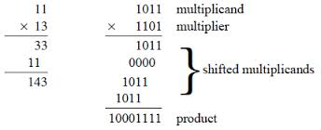
FIXED POINT MULTIPLICATION & DIVISION
Multiplication
In every step
multiplicand is shifted
next bit of multiplier is examined (also a shifting step)
if this bit is 1, shifted multiplicand is added to the product

Slide 15
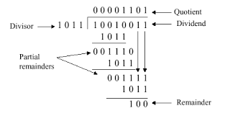
FIXED POINT MULTIPLICATION & DIVISION
Division
At every step, shift divisor right and compare it with current dividend
if divisor is larger, shift 0 as the next bit of the quotient
if divisor is smaller, subtract to get new dividend and shift 1 as the next bit of the quotient

Slide 16
FLOATING POINT REPRESENTATION
In computers, floating-point numbers are represented in scientific notation of fraction (F) and exponent (E) with a radix of 2, in the form of F×2^E. Both E and F can be positive as well as negative. Modern computers adopt IEEE 754 standard for representing floating-point numbers. There are two representation schemes: 32-bit single-precision and 64-bit double-precision.

Slide 17
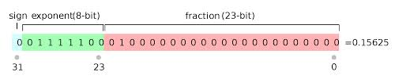
IEEE 754 FLOATING POINT REPRESENTATION
Single Precision
In 32-bit single-precision floating-point representation:
The most significant bit is the sign bit (S), with 0 for positive numbers and 1 for negative numbers.
The following 8 bits represent exponent (E).
The remaining 23 bits represents fraction (F).

Slide 18
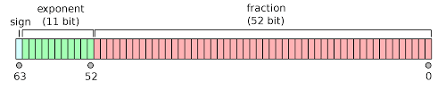
IEEE 754 FLOATING POINT REPRESENTATION
Double Precision
In 64-bit double-precision floating-point representation:
The most significant bit is the sign bit (S), with 0 for positive numbers and 1 for negative numbers.
The following 11 bits represent exponent (E).
The remaining 52 bits represents fraction (F).

Slide 19
IEEE 754 FLOATING POINT REPRESENTATION
Steps for converting:
Convert the number to binary and normalize it to the form
The sign is stored in the first bit of the word. S = 0 for +ve. S = 1 for -ve.
Add a bias to the true exponent e to get the stored exponent E. The bias is given by
where k is the number of exponent bits. Exponent bias = 127 for single precision and 1023 for double precision. Store the binary equivalent of E in the exponent field.
The first bit of the true significand is always 1 and need not be stored in the significand field. Stored the fraction part bbb…b in the significand field.

Slide 20
IEEE 754 FLOATING POINT - EXAMPLES
Examples
Convert the following decimal numbers to the IEEE-754 32-bit floating-point pattern. Represent the 32-bit result in hexadecimal.
12.125
-0.5625
-0.01225

Slide 21
IEEE 754 FLOATING POINT - EXAMPLES
Examples: Find the decimal number represented by the following IEEE-754 32-bit floating-point pattern is
0 10000000 110 0000 0000 0000 0000 0000.
Ans: +3.5
1 01111110 100 0000 0000 0000 0000 0000.
Ans: -0.75
1 01111110 000 0000 0000 0000 0000 0001.
Ans: -0.500000059604644775390625

Slide 22
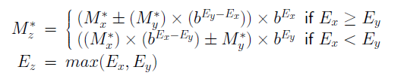
FLOATING-POINT ADDITION/SUBTRACTION
If x and y are normalized operands represented by (Sx, Mx, Ex) and (Sy, My, Ey)
Add/subtract significand and set exponent
Normalize significand and update exponent.
Round, normalize and adjust exponent.
Set flags for special case

Slide 23


FLOATING-POINT MULTIPLICATION
If x and y are normalized operands represented by (Sx, Mx, Ex) and (Sy, My, Ey)
Multiply significands, add exponents, and determine sign
Normalize and update exponent
Round
Determine exception flags and special values

Slide 24


FLOATING-POINT DIVISION
If x and y are normalized operands represented by (Sx, Mx, Ex) and (Sy, My, Ey)
Divide signicands, subtract exponents, and determine sign
Normalize and update exponent
Round
Determine exception flags and special values

